Slide 1
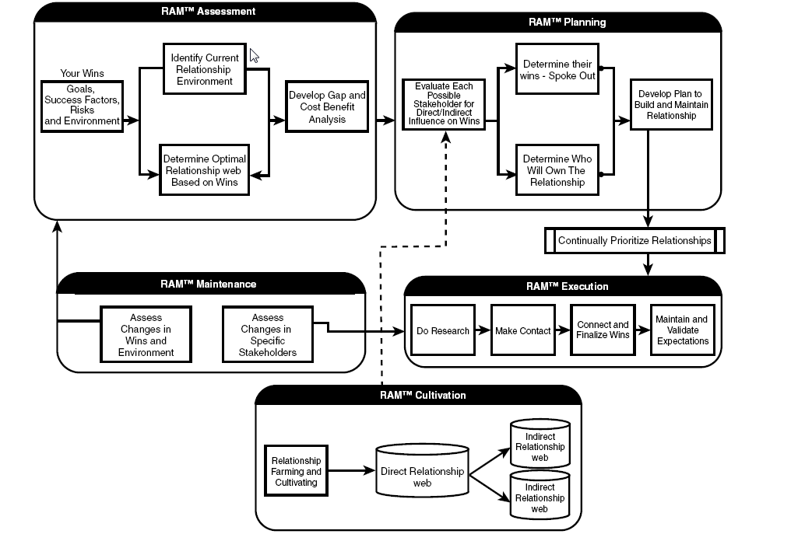
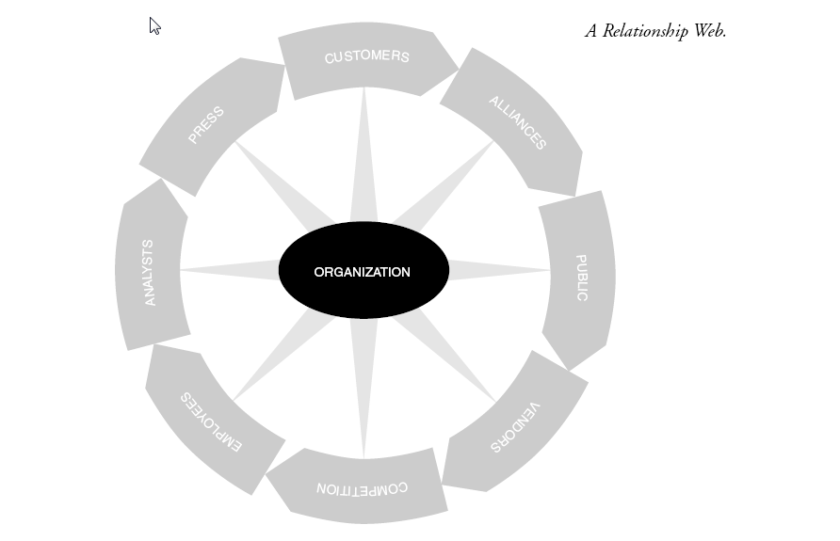

Librarianship is a Contact Sport
Anthony Molaro, MBA, MLIS
Grand Valley State University, Grand Rapids, MI
What?
The idea of Librarianship is a Contact Sport is based on the principles of Relationship Asset Management (RAM), found in Business is a Contact Sport by Tom Richardson and Augusto Vidaurreta. These principles rest on the belief that relationships are valuable assets. As librarians, we tend to focus on our collections and resources, but all of our assets help us to reach our goals. According to Richardson and Vidaurreta, “…a major reason so many companies don’t manage their relationships as assets is that managers don’t fully understand the role that relationships play in reaching goals.”
The Twelve Principles
Relationships helping us achieve our goals
Step 1. Evaluate relationship assets in light of goals, success factors, and risks.
  Define organizational goals
  Assess the key success factors involved in achieving those goals
  Understand all critical risks
  Identify stakeholders who can help the (organization) reach the goals, enhance success factors, and mitigate risks
Step 2. Assign an owner to the relationship (Chief Relationship Officer)
Step 3. Define wins for all parties in each relationship win-win, win-lose, lose-win and lose-lose.
Step 4. Move the relationship into the win-win zone, and keep it there.
See relationships as valuable assets | 2. Develop a game plan
3. Create ownership for relationships | 4. Transform contacts into connections
5. Move into a win-win zone | 6. Get to know your stakeholders as people
7. Build bonds of trust with all stakeholders | 8. Banish relationship killers
9. When something breaks, fix it fast | 10. Get rolling and maintain momentum
11. Maximize the long-term value of relationships | 12. Keep the wins coming, stakeholder by stakeholder
Why?
As Samuel Swett Green said over one hundred years ago, “One of the best means of making a library popular is to mingle freely with its users, and help them in every way… and [as] the conviction spreads through the community that the library is an institution of such beneficent influences that it can not be dispensed with.” According to the RAM principles to mingle freely with all of our relationships would make a library popular and help it achieve its goals.
Source: . Richardson, T., Vidaurreta, A., & Gorman, T. Business is a contact sport. (2001).
Source: . Richardson, T., Vidaurreta, A., & Gorman, T. Business is a contact sport. (2001).

